Slide 1

Employee Attrition Analysis
By
Aniket Jamdade

Slide 2
Introduction
This company founded a few years ago, has been experiencing a consistent 15% attrition rate over the past couple of years, significantly impacting its operations. To address this issue, it has enlisted the help of an HR analytics consultancy to analyze its data. As the HR analyst on this project, I aim to create a dashboard to assist the organization in making data-driven decisions to reduce employee turnover.

Slide 3
Details of the Data
These data provide comprehensive details of the factors that may influence an employee's decision to stay with or leave the company. By analyzing this data, we can identify patterns and trends contributing to employee turnover, allowing the company to make informed decisions to reduce attrition rates.
Age: The age of the employee
Attrition: Indicates if the employee has left the company (Yes/No)
Department: The department the employee works in
MonthlyIncome: Monthly salary of the employee
JobRole: Role of the employee within the company
YearsAtCompany: Number of years the employee has been with the company
JobSatisfaction: Employee's job satisfaction level (1-4)

Slide 4
Main KPIs
Total Attritions: Total number of employees who left the company
Attrition Rate: Percentage of employees who left the company
Average Age: Average age of employees
Average Salary: Average monthly salary of employees
Average Experience: Average number of years employees have worked at the company

Slide 5
Insights
Attrition By Education: Donut chart showing the distribution of employees from different educational backgrounds who left the company. Medical and Life Sciences have the highest attrition rates.
Attrition By Salary Slabs: Bar chart indicating that lower-salary employees are more likely to leave the company.
Attrition By Years at Company: Bar chart showing that employees with only one year at the company are leaving earlier than others.
Attrition By Gender: Chart showing that more males are leaving the company compared to females.
Attrition By Age and Gender: Stacked bar chart showing that employees aged 18-30, primarily males, are the most likely to leave the company.
Attrition By Job Role: A bar chart indicating that employees in Sales, Research, and Lab Technicians roles have the highest attrition rates, with Sales being the highest.

Slide 6
Conclusions
To reduce attrition, the company should implement targeted retention strategies. For younger employees and those with lower salaries, offering competitive pay and career growth opportunities could help. Improving job satisfaction and work-life balance, especially for Sales and Lab Technicians, is essential. Creating a supportive work environment for employees with Medical and Life Sciences backgrounds may also help retain talent.

Slide 7
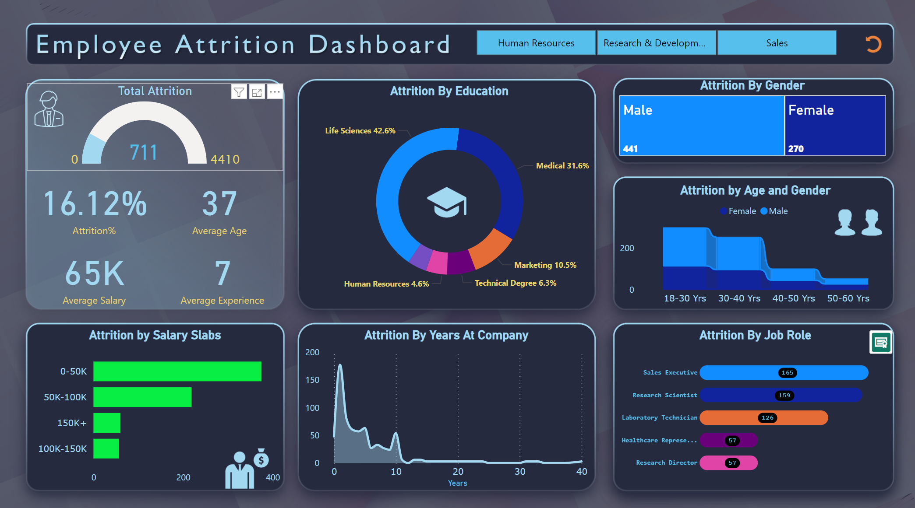
My Design
Link

Slide 8
Thank You

